Slide 1
Computer Security
Threats – Virus, Worms, Trojan Horse
Recent Spy Apps, Hackers, OS Types
E-Gadgets
Hands on Session on
Creation of Dashboard Using Excel
Dr. N. GANESH M.E. [CSE]., MBA[HR]., M.L.[IPR]., Ph.D. [CSE]
Associate Professor – Senior,
School of Computer Science and Engineering,
Vellore Institute of Technology,
Chennai Campus
Email: gannram@gmail.com
Mobile: 9841737667

Slide 2


Slide 3
Computer Architecture
In computer engineering, computer architecture is a set of rules and methods that describe the functionality, organization, and implementation of computer systems.
Computer architecture and types
Computer architecture consists of rules and methods or procedures which describe the implementation, functionality of the computer systems.
Computer architecture based on its performance, efficiency, reliability, and cost of the computer system.
It deals with software and hardware technology standards.

Slide 4

Virus
A computer virus is a carefully hidden piece of computer code that has the ability to spread from one system to another
A virus can do significant damage, or at least it may become a nuisance and interrupt productivity
Like a virus that spreads between human beings, a computer virus spreads between machines
But a computer virus is not actually alive; it's a piece of executable code that spreads because it is attached to a computer file
So, wherever the file goes, the virus goes with.

Slide 5

Worm
A worm virus is a computer virus that can self-replicate, mostly without human intervention. ... The ILOVEYOU, Michelangelo, and MSBlast worms are famous examples.
It is best to protect against a worm virus by installing antivirus software right away, rather than waiting to get infected before installing an antivirus tool.

Slide 6

Trojan Horse
In computing, a Trojan horse is a program downloaded and installed on a computer that appears harmless, but is, in fact, malicious
Unexpected changes to computer settings and unusual activity, even when the computer should be idle, are strong indications that a Trojan is residing on a computer.
Typically, the Trojan horse is hidden in an innocent-looking email attachment or free download
When the user clicks on the email attachment or downloads the free program, the malware that is hidden inside is transferred to the user's computing device
Once inside, the malicious code can execute whatever task the attacker designed it to carry out.
Here is one example of how a Trojan horse might be used to infect a personal computer: The victim receives an official-looking email with an attachment. The attachment contains malicious code that is executed as soon as the victim clicks on the attachment.
Example: derp

Slide 7

Spy Apps
The word spy alone screams scandal. In a time where illegal hacking and camera access have made many IT experts and big entrepreneurs apprehensive, it is quite normal to feel a little cynical about digital spying.

Slide 8
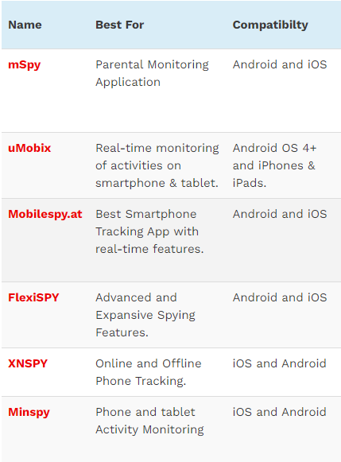
Top spy apps
mSpy
uMobix
Mobilespy.at
FlexiSPY
XNSPY
Minspy
SpyBubble
Spyier
Spyic
MobiStealth
iSpyoo
Spyera
iKeyMonitor
Highster Mobile’s Spy App
Hoverwatch
SpyFone

Slide 9
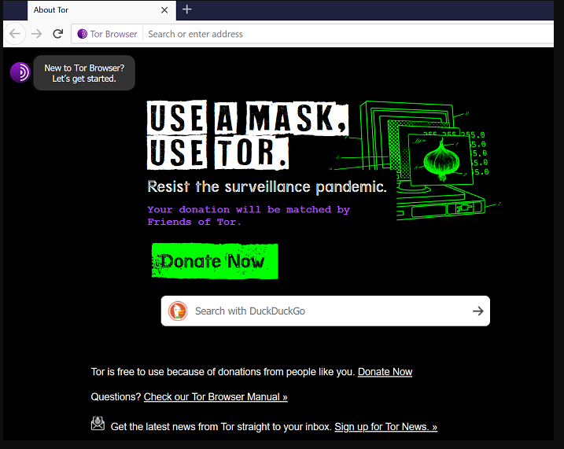

Tor Deep web
Tor is an anonymity network that hides your identity as you browse the web, share content, and engage in other online activities. It encrypts any data sent from your computer so that no one can see who or where you are, even when you're logged into a website.

Slide 10
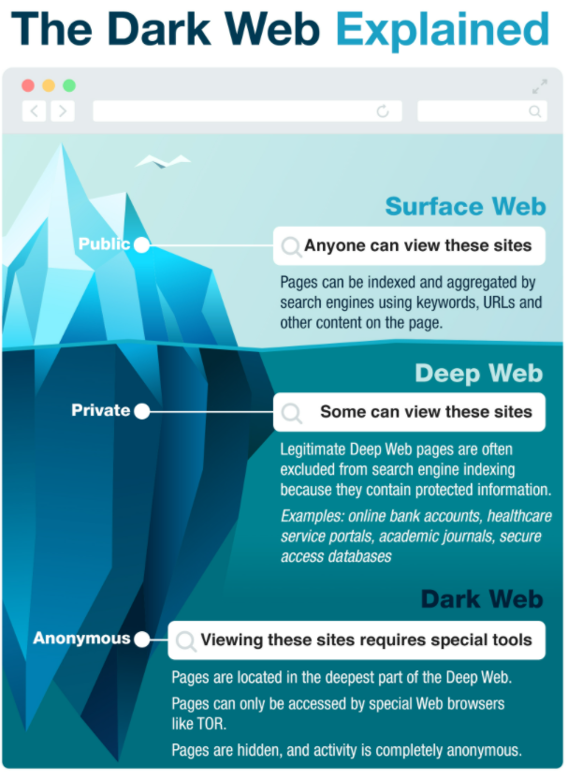
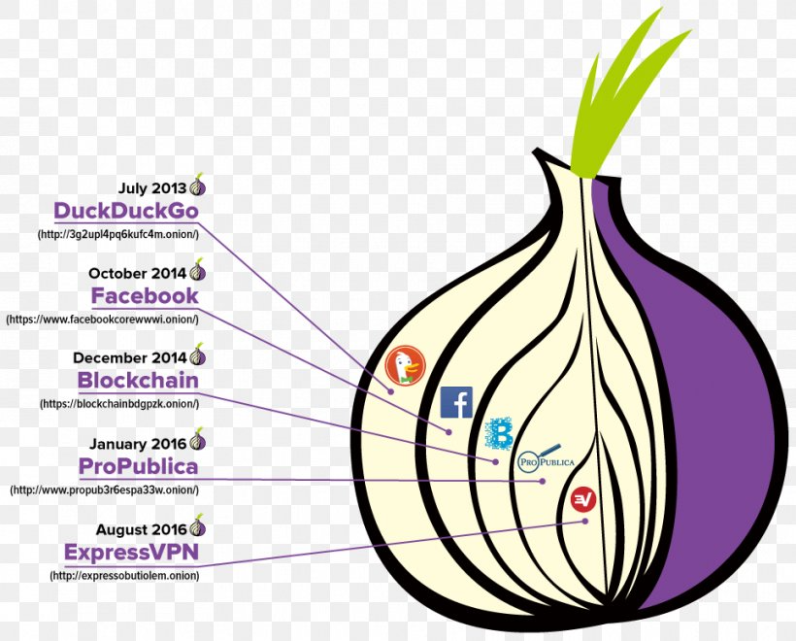

Slide 11

Hackers
A computer hacker is a computer expert who uses their technical knowledge to achieve a goal or overcome an obstacle, within a computerized system by non-standard means
Someone who utilizes their technical know-how of bugs or exploits to break into computer systems and access data which would otherwise be unavailable to them – hacking can also be utilized by legitimate figures in legal situations.
For example, law enforcement agencies sometimes use hacking techniques in order to collect evidence on criminals and other malicious actors.

Slide 12
Types of hackers

Slide 13
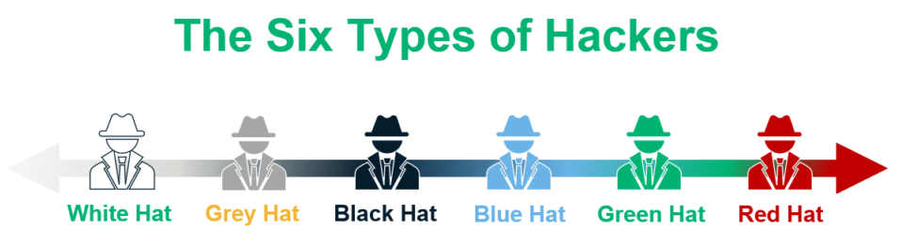
Types of Hackers

Slide 14
White Hat Hackers
White hat hackers are types of hackers who’re professionals with expertise in cybersecurity. They are authorized or certified to hack the systems.
These White Hat Hackers work for governments or organizations by getting into the system. They hack the system from the loopholes in the cybersecurity of the organization. This hacking is done to test the level of cybersecurity in their organization.
By doing so, they identify the weak points and fix them to avoid attacks from external sources. White hat hackers work as per the rules and regulations set by the government. White hat hackers are also known as ethical hackers.
Motives & Aims:
The goals of these types of hackers are helping businesses and an appetite for detecting gaps in networks’ security. They aim to protect and assist companies in the ongoing battle against cyber threats.
A White Hat hacker is any individual who will help protect the company from raising cyber crimes. They help enterprises create defence, detect vulnerabilities, and solve them before other cybercriminals can find them.

Slide 15
Gray Hat Hackers
The intention behind the hacking is considered while categorizing the hacker. The Gray hat hacker falls in between the black hat hackers and white hat hackers. They are not certified, hackers.
These types of hackers work with either good or bad intentions.
The hacking might be for their gain.
The intention behind hacking decides the type of hacker.
If the intention is for personal gain then the hacker is considered to be a gray hat hacker.
Motives & Aims: The difference is, they don’t want to rob people nor want to help people in particular. Rather, they enjoy experimenting with systems to find loopholes, crack defenses, and generally find a fun hacking experience.

Slide 16
Black Hat Hackers
Black hat hackers are also knowledgeable computer experts but with the wrong intention. They attack other systems to get access to systems where they do not have authorized entry. On gaining entry they might steal the data or destroy the system.
The hacking practices used by these types of hackers depend on the individual’s hacking capacity and knowledge.
As the intentions of the hacker make the hacker a criminal.
The malicious action intent of the individual cannot be gauged either can the extent of the breach while hacking
Motives & Aims: To hack into organizations’ networks and steal bank data, funds or sensitive information. Normally, they use the stolen resources to profit themselves, sell them on the black market or harass their target company.

Slide 17
Script Kiddies
It is a known fact that half knowledge is always dangerous. The Script Kiddies are amateurs types of hackers in the field of hacking. They try to hack the system with scripts from other fellow hackers. They try to hack the systems, networks, or websites.
The intention behind the hacking is just to get attention from their peers.
Script Kiddies are juveniles who do not have complete knowledge of the hacking process.
Motives & Aims: One standard Kiddie Script attack is a DoS (Denial of Service) or DDoS attack (Distributed Denial of Service).
This simply means that an IP address is flooded with too many excessive traffic that it collapses.
Consider several Black Friday shopping websites, for instance. It creates confusion and prevents someone else uses the service.

Slide 18
Blue Hat Hackers
Blue Hat Hackers are types of hackers who’re similar to Script Kiddies.
The intent to learn is missing.
They use hacking as a weapon to gain popularity among their fellow beings.
They use hacking to settle scores with their adversaries.
Blue Hat Hackers are dangerous due to the intent behind the hacking rather than their knowledge.

Slide 19
Green Hat Hackers
Green hat hackers are types of hackers who’re learning the ropes of hacking.
They are slightly different from the Script Kiddies due to their intention.
The intent is to strive and learn to become full-fledged hackers.
They are looking for opportunities to learn from experienced hackers.

Slide 20
Red Hat Hackers
Red Hat Hackers are synonymous with Eagle-Eyed Hackers. They are the types of hackers who’re similar to white hackers.
The red hat hackers intend to stop the attack of black hat hackers.
The difference between red hat hackers and white hat hackers is in the process of hacking through intention remains the same.
Red hat hackers are quite ruthless while dealing with black hat hackers or counteracting with malware.
The red hat hackers continue to attack and may end up having to replace the entire system set up.

Slide 21
State/Nation Sponsored Hackers
Government appoints hackers to gain information about other countries.
These types of hackers are known as State/Nation sponsored hackers.
They use their knowledge to gain confidential information from other countries to be well prepared for any upcoming danger to their country.
The sensitive information aids to be on top of every situation but also to avoid upcoming danger.
They report only to their governments.

Slide 22
Hacktivist
These types of hackers intend to hack government websites.
They pose themselves as activists, so known as a hacktivist.
Hacktivist can be an individual or a bunch of nameless hackers whose intent is to gain access to government websites and networks.
The data gained from government files accessed are used for personal political or social gain.

Slide 23
Malicious insider or Whistleblower
These types of hackers include individuals working in an organization who can expose confidential information.
The intent behind the exposure might be a personal grudge with the organization or the individual might have come across the illegal activities within the organization.
The reason for expose defines the intent behind the exposure.
These individuals are known as whistleblowers. .

Slide 24

One Plus 8T
Infra Red Camera
Photo Chrome mode

Slide 25
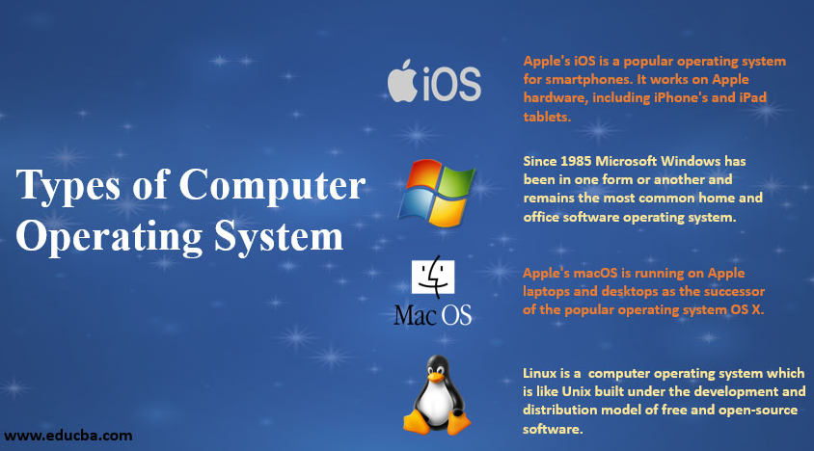
OS Types

Slide 26
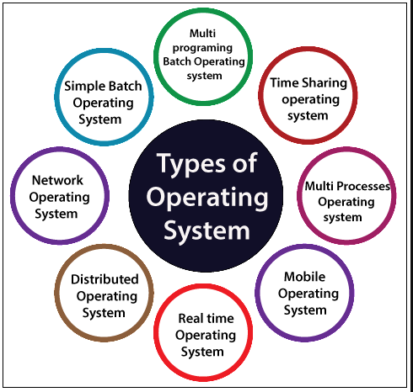
OS Types

Slide 27
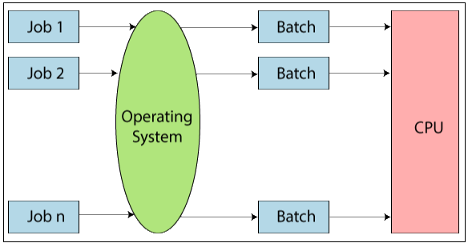
Simple Batch operating system
In the simple batch operating system, there is no direct communication between the user and the computer. In this, firstly, the user submits a job to the computer operator, and after submitting the job, the computer operator creates a batch of the jobs on an input device. The batch of jobs is created on the basis of the type of language and needs. After the batch of the job is created, then a special program monitors and manages each program in a batch.
Example: Bank Statements, Payroll system, etc.
Advantages of Simple Batch Operating System
There is no mechanism to prioritize the processes.
There is no communication between the user and the computer.
The ideal time is very less for a batch operating system.
Disadvantages of a Simple Batch Operating System
It is hard to debug.
The Batch operating systems are costly.

Slide 28
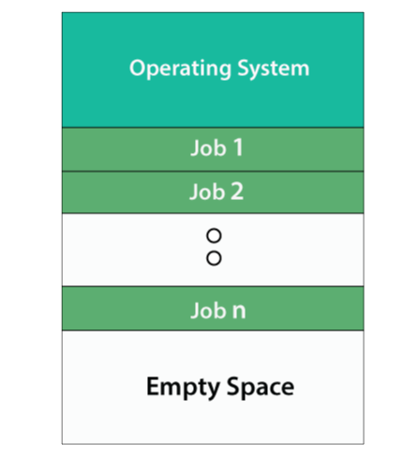
Multiprogramming Batch Operating System
In Multiprogramming Batch Operating System, the Operating system first selects the job, and after selecting the job, it begins to execute one of the jobs from memory. When this job requires an I/O operation operating system, it switches to another job (operating system and CPU always busy).
In this, the jobs present in memory are always minimum than the jobs present in the job pool.
If different jobs are ready to execute at the same time, then the job is selected for CPU scheduling.
In a simple batch operating system, sometimes CPU is idle and doesn’t perform any task, but in the multiprogramming batch operating system, CPU is busy and will never sit idle and always keeps on processing.

Slide 29
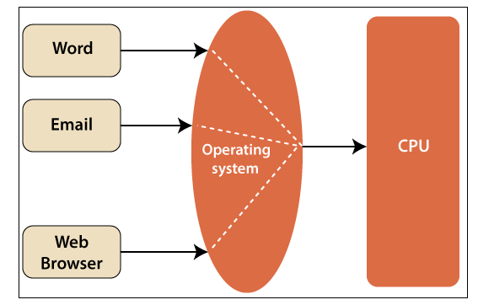
Time-Sharing Operating System
The Time-sharing systems are also called Multitasking systems. In Time-sharing operating system, we assign some time to each job so that all the jobs work efficiently and smoothly. The task may be from a single user as well as multiple users.
The time taken by each job to execute the job is known as quantum.
After the interval of time is over, the operating system moves to the next task. Time-sharing allows the various number of users to be placed at various terminals so that they can use a particular system at the same time.
Time-sharing is sharing the processor’s time with multiple users simultaneously.
Advantages of Time-Sharing Operating System
CPU remains idle for less time.
No partiality occurs between the jobs.
It quickly responses.
Disadvantages of Time-Sharing Operating System
The Problem of Data commination.
Not reliable

Slide 30
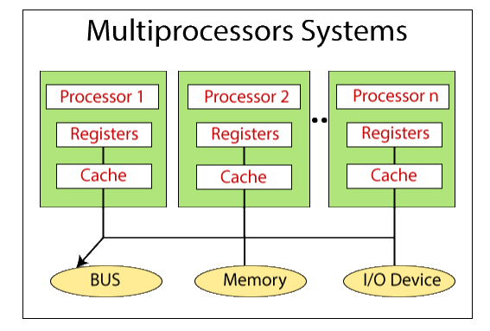
Multiprocessor Operating System
A Multiprocessor Operating System means the use of two or more processors within a single computer system. These multiple pro
cessors are in close communication and share the memory,
computer bus, and other peripheral devices.
These systems are known as tightly coupled systems.
It offers high speed and computing power.
In Multiprocessor operating system, all the processors work by using a single operating system.
Advantages of Multiprocessor
Improved performance.
By maximizing the number of processors, more work is done in less time. In this way, throughput is increased.
Increased reliability.
.

Slide 31
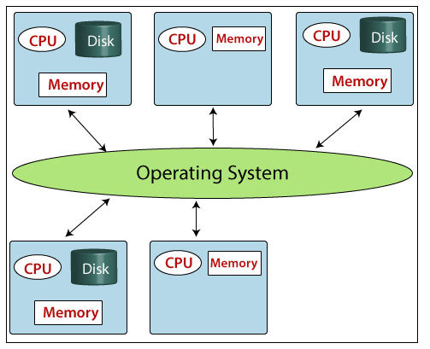
Distributed Operating System
Distributed Operating System
Distributed systems are also known as loosely coupled systems. In this type of operating system, multiple central processors are used to serve multiple real-time applications and multiple users. In this, the jobs of data processing are shared in the processors accordingly.
In this processor, interaction with each other takes place via communication lines like telephone lines, high-speed buses, etc. The processors can be different in function and size.
Types of Distributed Operating System
There are two types of Operating System:
Client-server Systems.
Peer-to-Peer system.
Advantages of Distributed Operating System
The advantages of a distributed system are:
Speed is increased by the exchange of information with the help of electronic mail.
It offers better services to customers.
Reduce delays in the processing of data.
By resource sharing ability, a user at one site can access the resources that are available at another site.
It offers reliability. If, in any case, one site fails then, the rest of the other sites work properly.
Reduces load on the host computer.
Disadvantages of Distributed Operating System
Distributed systems are more expensive.
Failure of the central network stops the whole communication.

Slide 32
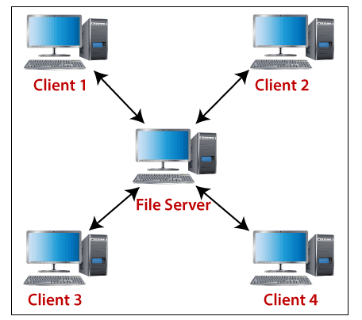
Network Operating System
The network operating systems are also called tightly coupled systems. A network operating system is a type of operating system which is created to help personal computer, workstations. Network operating systems are operated on a server and offer the facility of security, users, applications, data management, and other networking related functions. Its objective is to permit file sharing and printer access among various computers in a network, i.e., local area network (LAN), Private network, etc.
Example of Operating System: Unix, Linux, Novell NetWare, BSD, Microsoft Windows Server 2008.
Advantages of Networking Operating System
Provide the facility of remote access to servers from different locations.
Allows easy upgradation of new technologies.
Improves scalability.
Security is managed via the servers.
Disadvantages of Networking Operating System
Needed regular updates and maintenance.
It is expensive.
Many operations depend on a central location.

Slide 33
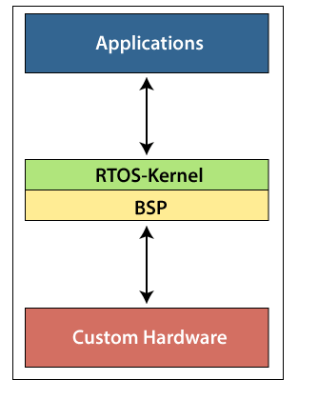
Real-Time Operating System
Real-time operating systems are the operating systems that are used in real-time applications where the data processing must be done in a fixed interval of time. The Real-time operating system gives the response very fast and quick. The Real-time operating system is used when a large number of events are processed in a short interval of time.
A real-time operating system is different from another operating system because, in this, time concept is the most crucial part. It is based on clock interrupts. In the real-time system, the process is executed on the basis of priority. The high priority process always executes first. When a high priority process enters into the system, the low priority process preempts to serve a high priority process. The task of synchronizing the process is done by the real-time operating system so that the process can interact with each other efficiently. In this way, resources are used effectively without time-wasting.
Example of the real-time operating system: Medical imaging systems, Industrial system, Nuclear reactors control scientific experiments, Traffic controlling signal, Military software system, Airline resolution system, Networked multimedia systems, Internet telephony, etc.
Types of Real-Time Operating System
There are three types of Real-time operating system:
Hard Real-time
Soft Real-time
Firm Real-time

Slide 34
Mobile Operating System
Mobile Operating System is the type of operating system which is mainly designed to power smartphones, wearables devices, and tablets.
Example: – Android, BlackBerry, WatchOS.

Slide 35
E-Gadgets

Slide 36
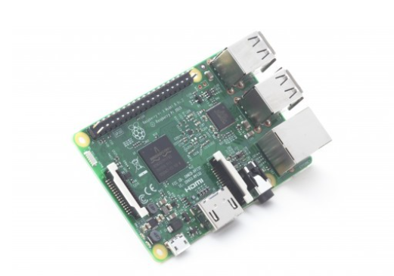
Raspberry Pi 3
We are now on the third generation of these low-budget computers, which can be used in multiple ways. A classic example in security audits is to use a Raspberry Pi with its appropriate battery pack, a distribution platform like Kali Linux, and applications like FruityWifi – To audit wireless networks

Slide 37
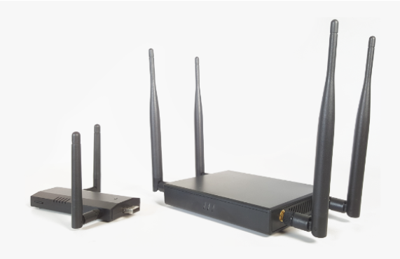
WiFi Pineapple
This set of tools for wireless penetration tests is very useful for various types of attacks, such as man-in-the-middle attack. Through an intuitive web interface, it enables you to connect using any device, such as a smartphone or a tablet. It stands out for its ease of use, workflow management, the detailed information it provides, and the possibility it offers to emulate different kinds of advanced attacks, which are always just a couple of clicks away.
As a platform, WiFi Pineapple allows the use of a great many modules, which are continually being developed by the user community, thus adding new features that widen its scope of functionality. The icing on the cake is that these modules can be installed free of charge directly via the web interface in a matter of seconds.

Slide 38

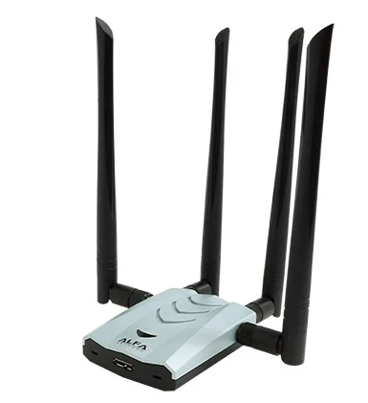
Alfa Network Board
A classic Wi-Fi board for injecting packets. The Alfa stands out for the quality of its materials, and for its use of chipsets which can be set to monitoring mode – a requirement for wireless audits.

Slide 39
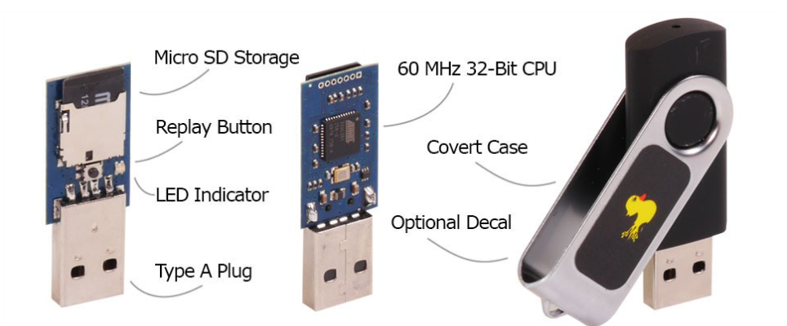
Rubber Ducky
This “special” pen drive is a device that works as a programmed keyboard in the shape of a USB drive. When you plug it into a computer, it starts writing automatically to launch programs and tools which may either be available on the victim computer or loaded onto the drive’s onboard Micro SD, in order to extract information.

Slide 40
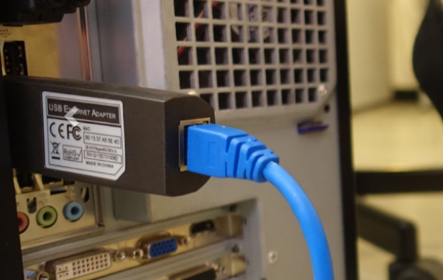
LAN Turtle
This type of systems admin and pen-test tool provides stealthy remote access, as it stays connected to a USB port covertly. Besides this, it allows users to harvest information from the network and has the capacity to execute a man-in-the-middle attack.

Slide 41
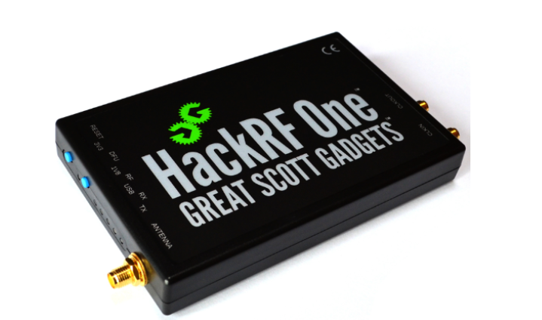
HackRF One
This tool installs a powerful SDR (Software-Defined Radio) system. In other words it is essentially a radio communication device which installs software to be used in place of typically installed hardware. This way, it is capable of processing all kinds of radio signals ranging from 10 MHz to 6 GHz from a single peripheral, which can be connected to the computer via a USB port.

Slide 42
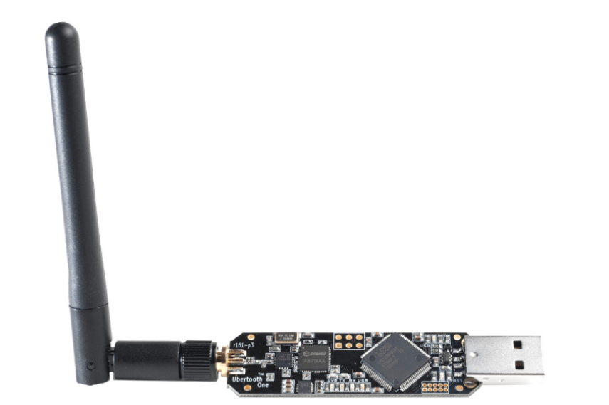
Ubertooth One
This device is an open-source 2.4 GHz code development platform for experimenting with Bluetooth, enabling users to appreciate the different aspects of new wireless technologies.

Slide 43
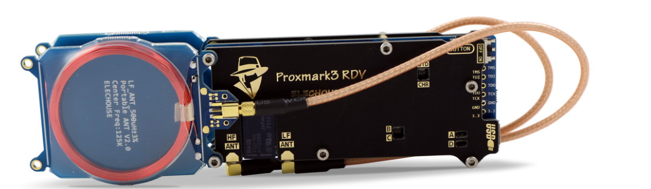
Proxmark3 Kit
The Proxmark3 is a device developed by Jonathan Westhues that can read almost any RFID (radio frequency identification) label, as well as clone and sniff them. It can also be operated in standalone mode (i.e. without a PC) through the use of batteries.
Example: Debit Card Tapping

Slide 44

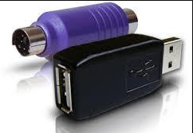
Keylogger
An old classic for logging keystrokes. This device can be connected via USB or PS/2 and creates a stealthy connection between the keyboard and PC, logging every keystroke. Of course, it tends to go undetected by most security systems.

Slide 45
Hands-On Session on Creation of Dashboard Using Excel
Populate from Excel Data
Group using Pivot Table and create Pivot Charts
Use Slicers
Use Timelines
Use Report Connections to activate all Graphs pertaining to Slicers
Use Design Layout for Better Outlook

Slide 46
Thank You

